Slide 1


Introduction to Java Programming and Data Structures
Twelfth Edition
Chapter 22
Developing Efficient Algorithms
Copyright © 2020 Pearson Education, Inc. All Rights Reserved
Notes:
If this PowerPoint presentation contains mathematical equations, you may need to check that your computer has the following installed:
1) MathType Plugin
2) Math Player (free versions available)
3) NVDA Reader (free versions available)
Slides in this presentation contain hyperlinks. JAWS users should be able to get a list of links by using INSERT+F7

Slide 2
Objectives (1 of 2)
22.1 To estimate algorithm efficiency using the Big notation (§22.2).
22.2 To explain growth rates and why constants and nondominating terms can be ignored in the estimation (§22.2).
22.3 To determine the complexity of various types of algorithms (§22.3).
22.4 To analyze the binary search algorithm (§22.4.1).
22.5 To analyze the selection sort algorithm (§22.4.2).
22.6 To analyze the insertion sort algorithm (§22.4.3).
22.7 To analyze the Tower of Hanoi algorithm (§22.4.4).
22.8 To describe common growth functions (constant, logarithmic, log-linear, quadratic, cubic, exponential) (§22.4.5).
22.8 To design efficient algorithms for finding Fibonacci numbers using dynamic programming (§22.5).
22.9 To find the G C D using Euclid’s algorithm (§22.6).

Slide 3
Objectives (2 of 2)
22.10 To finding prime numbers using the sieve of Eratosthenes (§22.7).
22.11 To design efficient algorithms for finding the closest pair of points using the divide-and-conquer approach (§22.8).
22.12 To solve the Eight Queens problem using the backtracking approach (§22.9).
22.13 To design efficient algorithms for finding a convex hull for a set of points (§22.10).

Slide 4
Executing Time
Suppose two algorithms perform the same task such as search (linear search vs. binary search). Which one is better? One possible approach to answer this question is to implement these algorithms in Java and run the programs to get execution time. But there are two problems for this approach:
First, there are many tasks running concurrently on a computer. The execution time of a particular program is dependent on the system load.
Second, the execution time is dependent on specific input. Consider linear search and binary search for example. If an element to be searched happens to be the first in the list, linear search will find the element quicker than binary search.

Slide 5
Growth Rate
It is very difficult to compare algorithms by measuring their execution time. To overcome these problems, a theoretical approach was developed to analyze algorithms independent of computers and specific input. This approach approximates the effect of a change on the size of the input. In this way, you can see how fast an algorithm’s execution time increases as the input size increases, so you can compare two algorithms by examining their growth rates.

Slide 6
Big O Notation
Consider linear search. The linear search algorithm compares the key with the elements in the array sequentially until the key is found or the array is exhausted. If the key is not in the array, it requires n comparisons for an array of size n. If the key is in the
array, it requires
comparisons on average. The algorithm’s
execution time is proportional to the size of the array. If you double the size of the array, you will expect the number of comparisons to double. The algorithm grows at a linear rate. The growth rate has an order of magnitude of n. Computer scientists use the Big O notation to abbreviate for “order of magnitude.” Using this notation,
the complexity of the linear search algorithm is
pronounced
as “order of n.”

Slide 7
Best, Worst, and Average Cases
For the same input size, an algorithm’s execution time may vary, depending on the input. An input that results in the shortest execution time is called the best-case input and an input that results in the longest execution time is called the worst-case input. Best-case and worst-case are not representative, but worst-case analysis is very useful. You can show that the algorithm will never be slower than the worst-case. An average-case analysis attempts to determine the average amount of time among all possible input of the same size. Average-case analysis is ideal, but difficult to perform, because it is hard to determine the relative probabilities and distributions of various input instances for many problems. Worst-case analysis is easier to obtain and is thus common. So, the analysis is generally conducted for the worst-case.

Slide 8
Ignoring Multiplicative Constants
The linear search algorithm requires n comparisons in the worst-
case and
comparisons in the average-case. Using the Big
O notation, both cases require
time. The multiplicative
constant
can be omitted. Algorithm analysis is focused
on growth rate. The multiplicative constants have no impact on
growth rates. The growth rate for
or 100n is the same as n,
i.e.,

Slide 9
Ignoring Non-Dominating Terms
Consider the algorithm for finding the maximum number in an array of n elements. If n is 2, it takes one comparison to find the maximum number. If n is 3, it takes two comparisons to find the maximum number. In
general, it takes
times of comparisons to find maximum number in
a list of n elements. Algorithm analysis is for large input size. If the input size is small, there is no significance to estimate an algorithm’s efficiency.
As n grows larger, the n part in the expression
dominates the
complexity. The Big O notation allows you to ignore the non-dominating
part (e.g.,
and highlight the important part (e.g.,
n in the expression
So, the complexity of this algorithm is

Slide 10
Useful Mathematic Summations
Notes:
a to the 0 power + a to the 1 power + a to the 2 power + a to the 3 power + ellipsis + a to the left parenthesis n minus 1 right parenthesis power + a to the n power = start fraction a to the n + 1 power minus 1 over a minus 1 end fraction
2 to the 0 power + 2 to the 1 power + 2 to the 2 power + 2 to the 3 power + ellipsis + 2 to the left parenthesis n minus 1 right parenthesis power + 2 to the n power = start fraction 2 to the n + 1 power minus 1 over 2 minus 1 end fraction

Slide 11
Examples: Determining Big-O
Repetition
Sequence
Selection
Logarithm

Slide 12
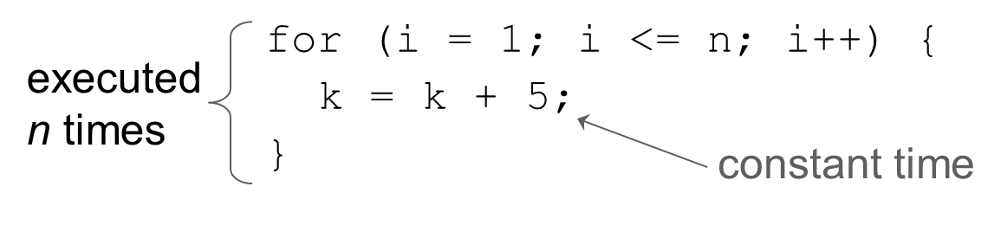
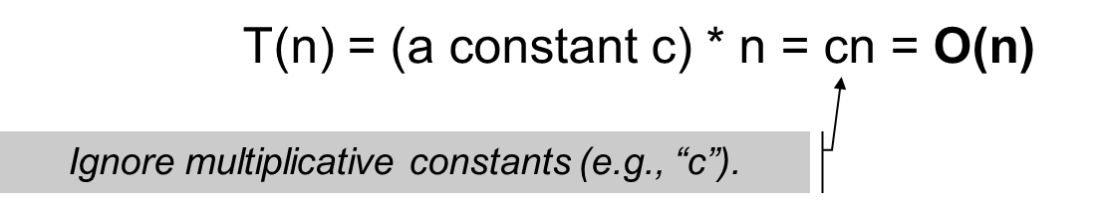
Repetition: Simple Loops
Time Complexity
PerformanceTest
Notes:
PerformanceTest: https://liveexample.pearsoncmg.com/html/PerformanceTest.html

Slide 13
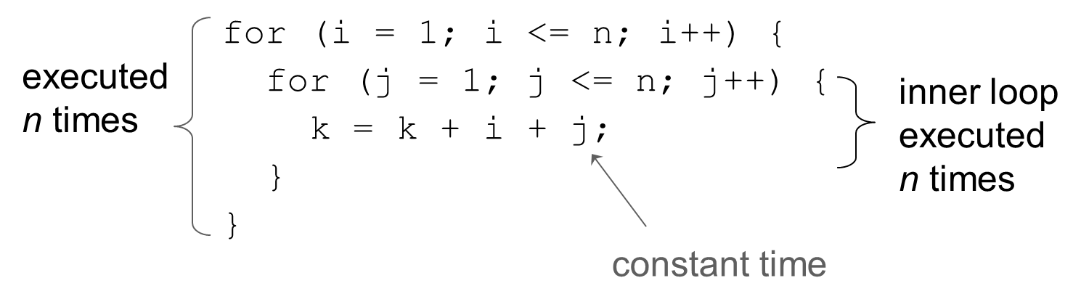
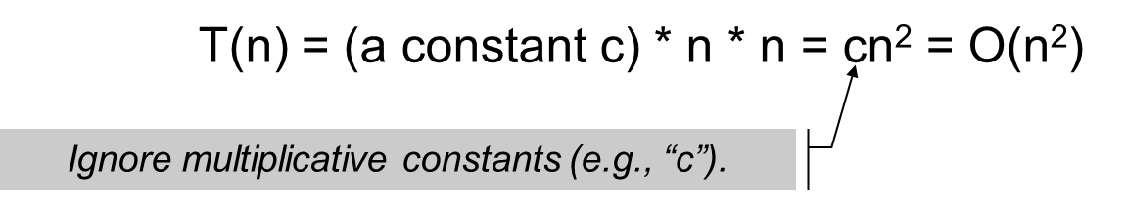
Repetition: Nested Loops (1 of 3)
Time Complexity

Slide 14
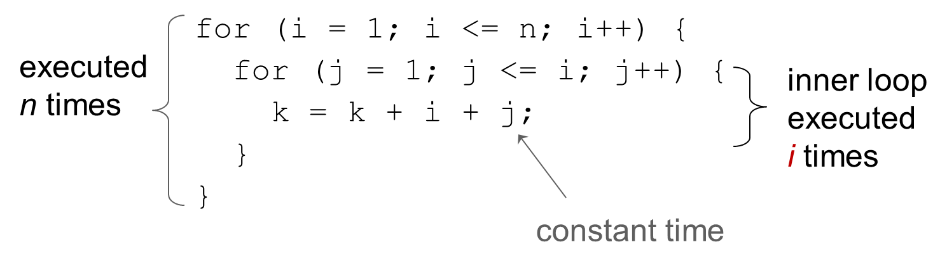
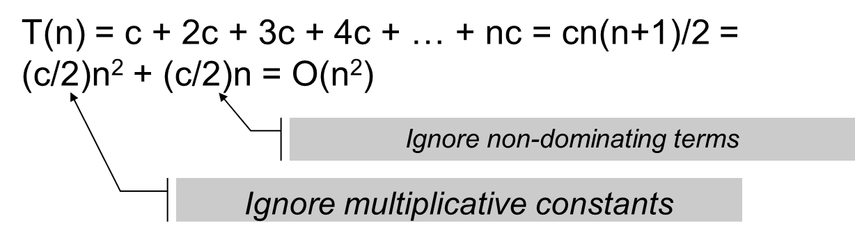
Repetition: Nested Loops (2 of 3)
Time Complexity

Slide 15
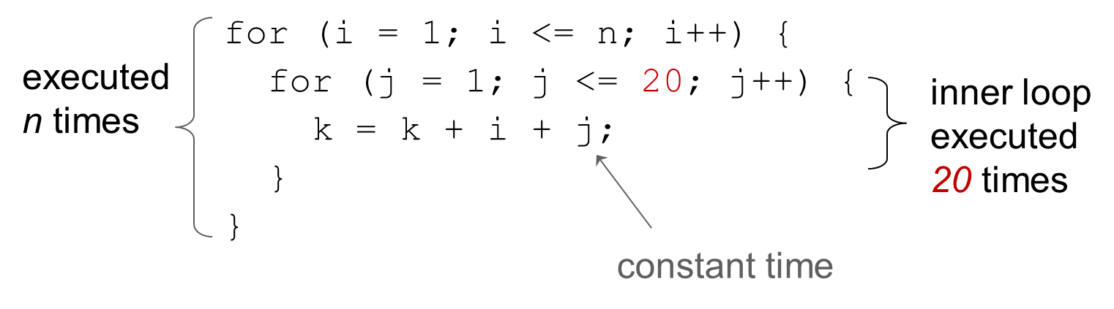
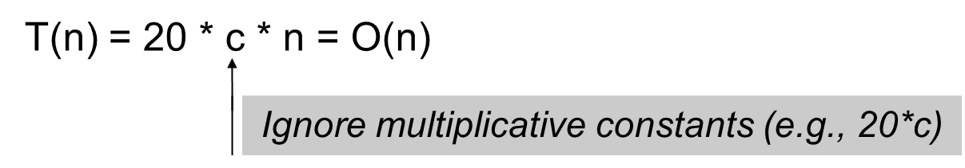
Repetition: Nested Loops (3 of 3)
Time Complexity

Slide 16

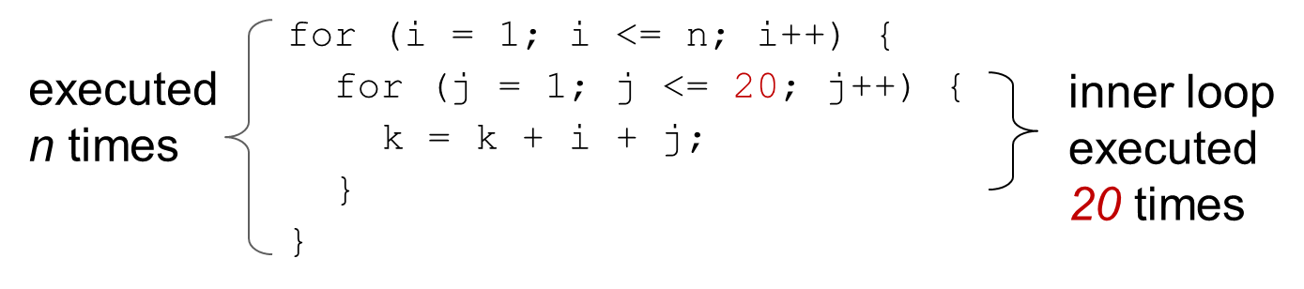
Sequence
Time Complexity

Slide 17
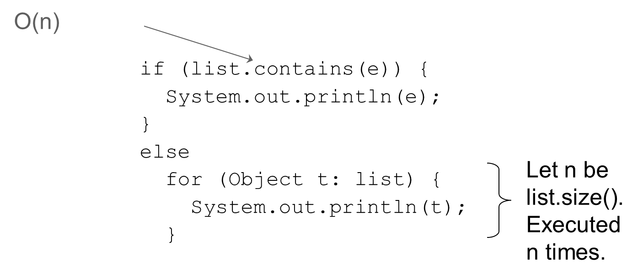
Selection
Time Complexity
Notes:
An arrow from O of n point to the code block below.
if left parenthesis list.contains left parenthesis e right parenthesis right parenthesis left brace
System.out.println left parenthesis e right parenthesis semi colon
right brace
else
for left parenthesis Object t colon list right parenthesis left brace
System.out.println left parenthesis t right parenthesis semi colon
right brace
The last two rows of codes are labeled, let n be list.size left parenthesis right parenthesis. Executed n times.

Slide 18
Constant Time
The Big O notation estimates the execution time of an algorithm in relation to the input size. If the time is not related to the input size, the algorithm is said to take constant time
with the notation
For example, a method that retrieves
an element at a given index in an array takes constant time, because it does not grow as the size of the array increases.

Slide 19
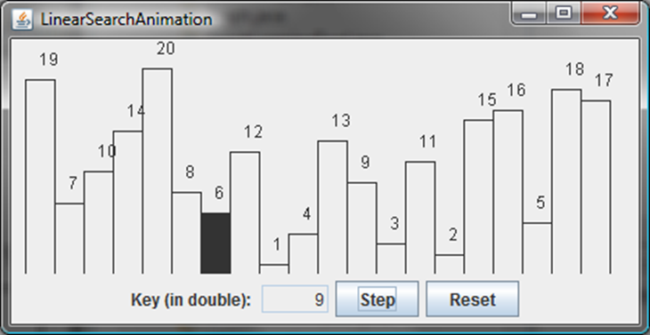
Linear Search Animation
https://liveexample.pearsoncmg.com/dsanimation/LinearSearcheBook.html
Notes:
The rectangle of height 6 is shaded. The text box for key (in double) has text 9 entered in it. The buttons step and reset are to the right of the text box.

Slide 20
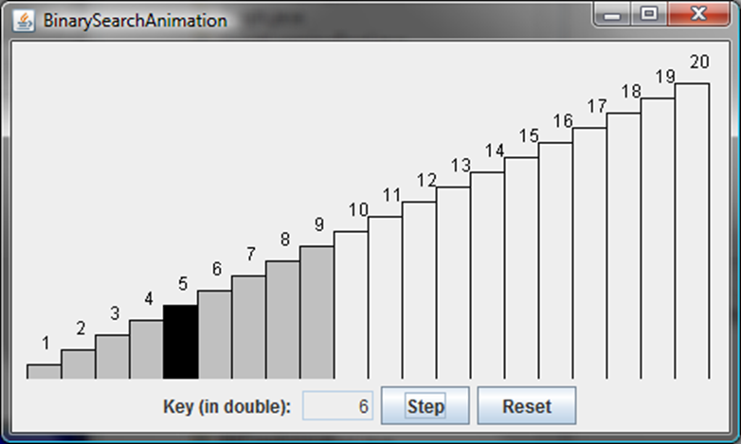
Binary Search Animation
https://liveexample.pearsoncmg.com/dsanimation/BinarySearcheBook.html
Notes:
The rectangle of height 5 is shaded. The text box for key (in double) has text 6 entered in it. The buttons step and reset are to the right of the text box.

Slide 21
Logarithm: Analyzing Binary Search
The binary search algorithm presented in Listing 7.7, BinarySearch.java, searches a key in a sorted array. Each iteration in the algorithm contains
a fixed number of operations, denoted by c. Let
denote the time
complexity for a binary search on a list of n elements. Without loss of
generality, assume n is a power of 2 and
Since binary search
eliminates half of the input after two comparisons,

Slide 22
Logarithmic Time
Ignoring constants and smaller terms, the complexity of the
binary search algorithm is
An algorithm with the
time complexity is called a logarithmic algorithm.
The base of the log is 2, but the base does not affect a logarithmic growth rate, so it can be omitted. The logarithmic algorithm grows slowly as the problem size increases. If you square the input size, you only double the time for the algorithm.

Slide 23
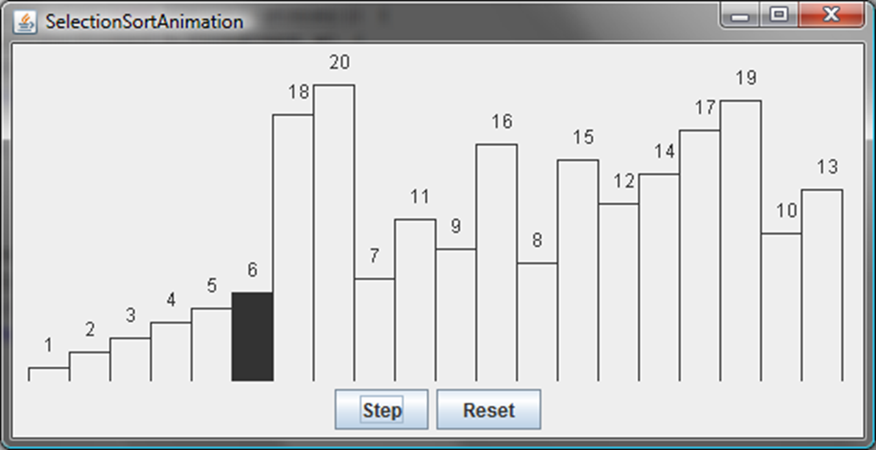
Selection Sort Animation
https://liveexample.pearsoncmg.com/dsanimation/SelectionSortNew.html
Notes:
The rectangle of height 6 is shaded. The buttons step and reset are to the right of the text box.

Slide 24
Analyzing Selection Sort
The selection sort algorithm presented in Listing 7.8, SelectionSort.java, finds the smallest number in the list and places it first. It then finds the smallest number remaining and places it second, and so on until the list
contains only a single number. The number of comparisons is
for the first iteration,
for the second iteration, and so on. Let
denote the complexity for selection sort and c denote the total number of other operations such as assignments and additional comparisons in each iteration. So,
Ignoring constants and smaller terms, the complexity of the selection
sort algorithm is

Slide 25
Quadratic Time
An algorithm with the
time complexity is called a
quadratic algorithm. The quadratic algorithm grows quickly as the problem size increases. If you double the input size, the time for the algorithm is quadrupled. Algorithms with a nested loop are often quadratic.

Slide 26
Analyzing Tower of Hanoi
The Tower of Hanoi problem presented in Listing 18.7, TowerOfHanoi.java, moves n disks from tower A to tower B with the assistance of tower C recursively as follows:
Move the first
disks from A to C with the assistance of tower B.
Move disk n from A to B.
Move
disks from C to B with the assistance of tower A.
Let
denote the complexity for the algorithm that moves disks and
c denote the constant time to move one disk, i.e.,
Notes:
= 2 left parenthesis 2 left parenthesis n minus 2 + c right parenthesis = 2 to the n minus 1 power T of 1 + c 2 to the n minus 2 power + ellipsis + c2 + c =
= c 2 to the n minus 1 power + c 2 to the n minus 2 power + ellipsis + c2 + c = c left parenthesis 2 to the n power minus 1 right parenthesis = O of 2 to the n power

Slide 27
Common Recurrence Relations
Recurrence Relation | Result | Example
T of n = T of n over 2 + O of 1 | T of n = O of log n | Binary search, Euclid’s G C D
T of n = T of n minus 1 + O of 1 | T of n = O of n | Linear search
T of n = 2 T of n over 2 + O of 1 | T of n = O of n | Blank
T of n = 2T of n over 2 + O of n | T of n = O of n log n | Merge sort (Chapter 24)
T of n = 2 T of n over 2 + O of n log n | T of n = O of n log squared n | Blank
T of n = T of n minus 1 + O of n | T of n = O of n squared | Selection sort, insertion sort
T of n = 2 T of n minus 1 + O of 1 | T of n = O of 2 to the n power | Towers of Hanoi
T of n = T of n minus 1 + T of n minus 2 + O of 1 | T of n = O of 2 to the n power | Recursive Fibonacci algorithm

Slide 28
Comparing Common Growth Functions (1 of 2)
Constant time
Logarithmic time
Linear time
Log-linear time
Quadratic time
Cubic time
Exponential time

Slide 29
Comparing Common Growth Functions (2 of 2)

Slide 30
Case Study: Fibonacci Numbers
/** The method for finding the Fibonacci number */
public static long fib(long index) {
if (index == 0) // Base case
return 0;
else if (index == 1) // Base case
return 1;
else // Reduction and recursive calls
}
Finonacci series: | 0 | 1 | 1 | 2 | 3 | 5 | 8 | 13 | 21 | 34 | 55 | 89…
indices: | 0 | 1 | 2 | 3 | 4 | 5 | 6 | 7 | 8 | 9 | 10 | 11
fib(0) = 0;
fib(1) = 1;

Slide 31
Complexity for Recursive Fibonacci Numbers
Since
and
Therefore, the recursive Fibonacci method takes
ComputeFibonacci
Notes:
ComputeFibonacci: https://liveexample.pearsoncmg.com/html/ComputeFibonacci.html

Slide 32
Case Study: Non-Recursive Version of Fibonacci Numbers (1 of 3)
public static long fib(long n) {
long f0 = 0; // For fib(0)
long f1 = 1; // For fib(1)
long f2 = 1; // For fib(2)
if (n == 0)
return f0;
else if (n == 1)
return f1;
else if (n == 2)
return f2;
for (int i = 3; i <= n; i++) {
f0 = f1;
f1 = f2;
f2 = f0 + f1;
}
return f2;
}
Obviously, the complexity of this new algorithm is. This is a tremendous improvement over the recursive algorithm.
ImprovedFibonacci
Notes:
ImprovedFibonacci: https://liveexample.pearsoncmg.com/html/ImprovedFibonacci.html

Slide 33
Case Study: Non-Recursive Version of Fibonacci Numbers (2 of 3)
 | f0 | f1 | f2
Fibonacci series: | 0 | 1 | 1 | 2 | 3 | 5 | 8 | 13 | 21 | 34 | 55 | 89…
indices: | 0 | 1 | 2 | 3 | 4 | 5 | 6 | 7 | 8 | 9 | 10 | 11
 |  | f0 | f1 | f2
Fibonacci series: | 0 | 1 | 1 | 2 | 3 | 5 | 8 | 13 | 21 | 34 | 55 | 89…
indices: | 0 | 1 | 2 | 3 | 4 | 5 | 6 | 7 | 8 | 9 | 10 | 11
 |  |  | f0 | f1 | f2
Fibonacci series: | 0 | 1 | 1 | 2 | 3 | 5 | 8 | 13 | 21 | 34 | 55 | 89…
indices: | 0 | 1 | 2 | 3 | 4 | 5 | 6 | 7 | 8 | 9 | 10 | 11

Slide 34
Case Study: Non-Recursive Version of Fibonacci Numbers (3 of 3)
 |  |  |  |  |  |  |  |  |  | f0 | f1 | f2
Fibonacci series: | 0 | 1 | 1 | 2 | 3 | 5 | 8 | 13 | 21 | 34 | 55 | 89…
indices: | 0 | 1 | 2 | 3 | 4 | 5 | 6 | 7 | 8 | 9 | 10 | 11

Slide 35
Dynamic Programming
The algorithm for computing Fibonacci numbers presented here uses an approach known as dynamic programming. Dynamic programming is to solve subproblems, then combine the solutions of subproblems to obtain an overall solution. This naturally leads to a recursive solution. However, it would be inefficient to use recursion, because the subproblems overlap. The key idea behind dynamic programming is to solve each subprogram only once and storing the results for subproblems for later use to avoid redundant computing of the subproblems.

Slide 36
Case Study: G C D Algorithms Version 1
public static int gcd(int m, int n) {
int gcd = 1;
for (int k = 2; k <= m && k <= n; k++) {
if (m % k == 0 && n % k == 0)
gcd = k;
}
return gcd;
}
Obviously, the complexity of this algorithm is

Slide 37
Case Study: G C D Algorithms Version 2
for (int k = n; k >= 1; k--) {
if (m % k == 0 && n % k == 0) {
gcd = k;
break;
}
}
The worst-case time complexity of this algorithm is still

Slide 38
Case Study: G C D Algorithms Version 3
public static int gcd(int m, int n) {
int gcd = 1;
if (m == n) return m;
for (int k = n / 2; k >= 1; k--) {
if (m % k == 0 && n % k == 0) {
gcd = k;
break;
}
}
return gcd;
}
The worst-case time complexity of this algorithm is still

Slide 39
Euclid’s Algorithm
Let gcd(m, n) denote the gcd for integers m and n:
If m % n is 0, gcd (m, n) is n.
Otherwise, gcd(m, n) is gcd(n, m % n).
m = n*k + r
if p is divisible by both m and n, it must be divisible by r

Slide 40
Euclid’s Algorithm Implementation
public static int gcd(int m, int n) {
if (m % n == 0)
return n;
else
return gcd(n, m % n);
}
The time complexity of this algorithm is
See the text
for the proof.

Slide 41
Finding Prime Numbers
Compare three versions:
PrimeNumber
PrimeNumbers
Brute-force
Check possible divisors up to Math.sqrt(n)
Check possible prime divisors up to Math.sqrt(n)
EfficientPrimeNumbers
SieveOfEratosthenes
Notes:
PrimeNumber: https://liveexample.pearsoncmg.com/html/PrimeNumber.html
PrimeNumbers: https://liveexample.pearsoncmg.com/html/PrimeNumbers.html
EfficientPrimeNumbers: https://liveexample.pearsoncmg.com/html/EfficientPrimeNumbers.html
SieveOfEratosthenes: https://liveexample.pearsoncmg.com/html/SieveOfEratosthenes.html

Slide 42
Divide-and-Conquer
The divide-and-conquer approach divides the problem into subproblems, solves the subproblems, then combines the solutions of subproblems to obtain the solution for the entire problem. Unlike the dynamic programming approach, the subproblems in the divide-and-conquer approach don’t overlap. A subproblem is like the original problem with a smaller size, so you can apply recursion to solve the problem. In fact, all the recursive problems follow the divide-and-conquer approach.

Slide 43
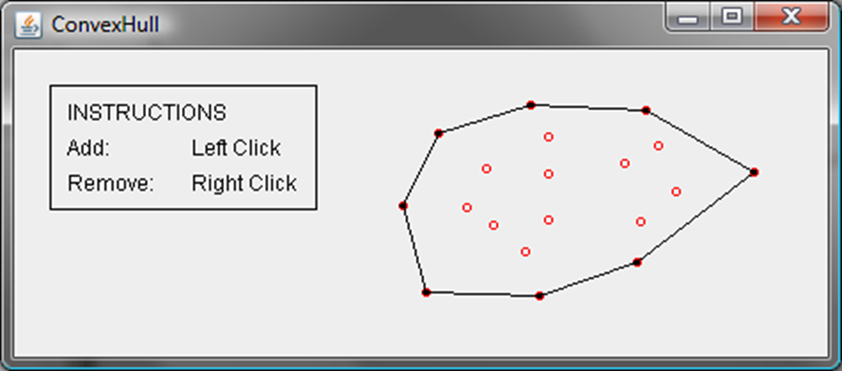
Convex Hull Animation
https://liveexample.pearsoncmg.com/dsanimation/ConvexHull.html

Slide 44
Convex Hull
Given a set of points, a convex hull is a smallest convex polygon that encloses all these points, as shown in Figure a. A polygon is convex if every line connecting two vertices is inside the polygon. For example, the vertices v0, v1, v2, v3, v4, and v5 in Figure a form a convex polygon, but not in Figure b, because the line that connects v3 and v1 is not inside the polygon.
Figure a
Figure b

Slide 45
Gift-Wrapping
Step 1: Given a set of points S, let the points in S be labeled s0, s1, ..., sk. Select the rightmost lowest point h0 in the set S. Let t0 be h0.
(Step 2: Find the rightmost point t1): Let t1 be s0. For every point p in S, if p is on the right side of the direct line from t0 to t1, then let t1 be p.
Step 3: If t1 is h0, done.
Step 4: Let t0 be t1, go to Step 2.

Slide 46
Gift-Wrapping Algorithm Time
Finding the rightmost lowest point in Step 1 can be done in
time. Whether a point is on the left side of a line,
right side, or on the line can decided in
time (see
Exercise 3.32). Thus, it takes
time to find a new point
t1 in Step 2. Step 2 is repeated h times, where h is the size
of the convex hull. Therefore, the algorithm takes
time. In the worst case, h is n.

Slide 47
Graham’s Algorithm (1 of 2)
Given a set of points S, select the rightmost lowest point and name it p0 in the set S. As shown in Figure 22.10a, p0 is such a point.
Sort the points in S angularly along the x-axis with p0 as the center. If there is a tie and two points have the same angle, discard the one that is closest to p0. The points in S
are now sorted as

Slide 48
Graham’s Algorithm (2 of 2)
The convex hull is discovered incrementally. Initially, p0, p1, and p2 form a convex hull. Consider p3. p3 is outside of the current convex hull since points are sorted in increasing order of their angles. If p3 is strictly on the left side of the line from p1 to p2, push p3 into H. Now p0, p1, p2, and p3 form a convex hull. If p3 is on the right side of the line from p1 to p2 (see Figure 22.10d), pop p2 out of H and push p3 into H. Now p0, p1, and p3 form a convex hull and p2 is inside of this convex hull.

Slide 49
Graham’s Algorithm Time

Slide 50
Practical Considerations
The big O notation provides a good theoretical estimate of algorithm efficiency. However, two algorithms of the same time complexity are not necessarily equally efficient. As shown in the preceding example, both algorithms in Listings 5.6 and 22.2 have the same complexity, but the one in Listing 22.2 is obviously better practically.

Slide 51

Copyright
This work is protected by United States copyright laws and is provided solely for the use of instructors in teaching their courses and assessing student learning. Dissemination or sale of any part of this work (including on the World Wide Web) will destroy the integrity of the work and is not permitted. The work and materials from it should never be made available to students except by instructors using the accompanying text in their classes. All recipients of this work are expected to abide by these restrictions and to honor the intended pedagogical purposes and the needs of other instructors who rely on these materials.

